Slide 1
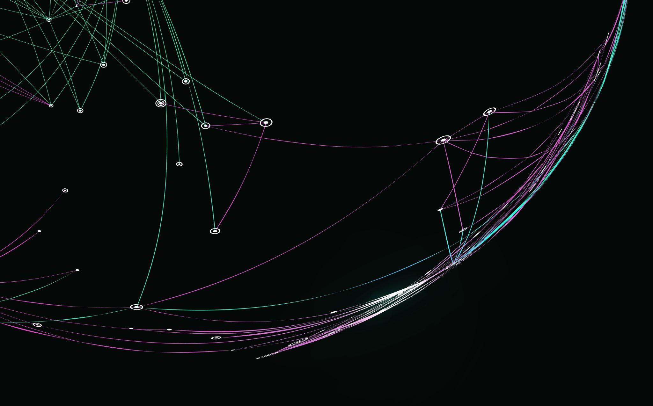
TEAM PROJECT
GROUP A3_5
6G4Z0021_2425_1
TEAM LEADER
PRODUCT OWNER
QUALITY CONTROLLER
TEAM MEMBER
TEAM MEMBER
KIERAN MOORE
FAVOUR OMOREGIE
NISHA MUSOKE
OMARION BEEN
CORA COYLE
LINE MANAGER – YANLONG ZHANG

Slide 2
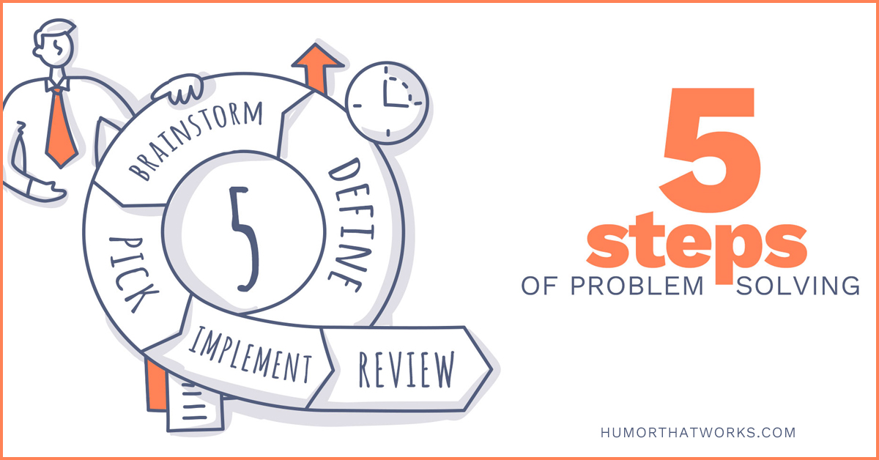
The Problem Domain
GROUP A3_5 TEAM PROJECT 24/25
Now presenting ;
Cora
Aims of the project
Create a web-based booking system that shows real-time availability of study spaces across campus that is integrated with university systems with features like interactive maps, booking management, and invitation capabilities for group study sessions.
The problem
Students find it hard to access free spaces within the university study areas and libraries usually because they are overcrowded. Universities offer a lot of study spaces but during peak hours of the day, it is difficult to find an available spot without wasting time searching.
The requirements needed for the problem
The app or platform needs to be integrated within the university systems which students/staff can easily access, use to reserve and check into the spaces.
The check in can be done by QR code or tapping ID.
With regards to privacy, presence sensors can be used to detect if a room is vacant instead of traditional motion sensors and cameras.
The system can adapt to learn trends and peak times to offer suggestions of alternate study places.
(Humour that works, The 5 steps of problem solving 2020)
Notes:
students find it hard to access study spaces
wasted time during peak study hours
integrate the solution with uni systems
check in with qr code or uni Id
use presence sensors to detect if a room is empty, keeps privacy
system learns trends with timings
create a web based booking system
features like interactive maps, booking management etc.

Slide 3
Planning phase
GROUP A3_5 TEAM PROJECT 24/25
Now presenting ;
Favour
How did we organise the team activity and working process?
Proper planning and Task allocation
(kick-off meeting, role assignment and task breakdown)
Workflow and Collaboration
(project management tools, version control and communication tools)
Development process
(sprint planning, development phase, mid-week check-ins, feedback, testing, reviews and integration)
Problem solving and adjustments
Final review and submission
What did we propose to do to address the problem?
A website was proposed that allowed students to book a room freely and without worrying that someone else would have booked the same room and at the same time which can cause inconvenience while studying.
How did we structure the project to implement your proposal?
The way the project was structured to implement the proposal was by making sure that every person in the team had a task to do which resulted in the final product.
Notes:
PART 1
PART 2
PART 3
1. Planning & Task Allocation
Kickoff Meeting: We started with a meeting to discuss the project scope, requirements, and objectives.
Role Assignment: Each member was assigned a role (Team Leader, Product Owner, Quality Controller, Developers).
Task Breakdown: We divided the project into different components:
Frontend Development (User interface, booking interface)
Backend Development ( authentication, booking system)
Testing & Quality Control
Documentation & Reports
2. Workflow & Collaboration
Project Management Tool: We used Trello/Notion to track tasks and deadlines.
Version Control: Used GitHub to collaborate on coding and prevent conflicts.
Communication Tools: Used WhatsApp/Discord for quick discussions and Google Meet for weekly meetings.
3. Development Process
We followed an iterative approach
Sprint Planning (Weekly) – Assigned tasks for the week and set goals.
Development Phase – Team members worked on their assigned tasks.
Mid-Week Check-In – Quick progress update to identify any roadblocks.
Testing & Feedback – The Quality Controller reviewed features and provided feedback
Final Review & Integration – Ensured everything worked smoothly before moving to the next phase.
4. Problem-Solving & Adjustments
If someone faced an issue, we discussed it in our group chat or during meetings.
The Team Leader helped resolve conflicts or reassign tasks if necessary.
The Product Owner ensured that all features met user expectations before implementation.
5. Final Review & Submission
Conducted a final testing phase to catch any bugs.
Prepared documentation and a final presentation.
Submitted the project after confirming everything was complete.
Structure:
For instance, the Quality controller had to overlook the product outcome and efficiency.

Slide 4

Design and Implementation
GROUP A3_5 TEAM PROJECT 24/25
Now presenting ;
Favour
How was the product structured, and designed?
The system will allow students to locate and reserve available spaces, check in when they arrive, and release spaces when they're done.
How was it implemented?
QR code check in or ID scanning for check ins. Each reservation is given a 10-minute grace period. If no check in then the room is made available on the platform to be used by someone else.
App or platform with live floor plan of spaces, with time slots of availability, able to filter out different zones like individual pods, quiet zones, group rooms, etc.
Invitation links for room bookings with calendar reminders

Slide 5
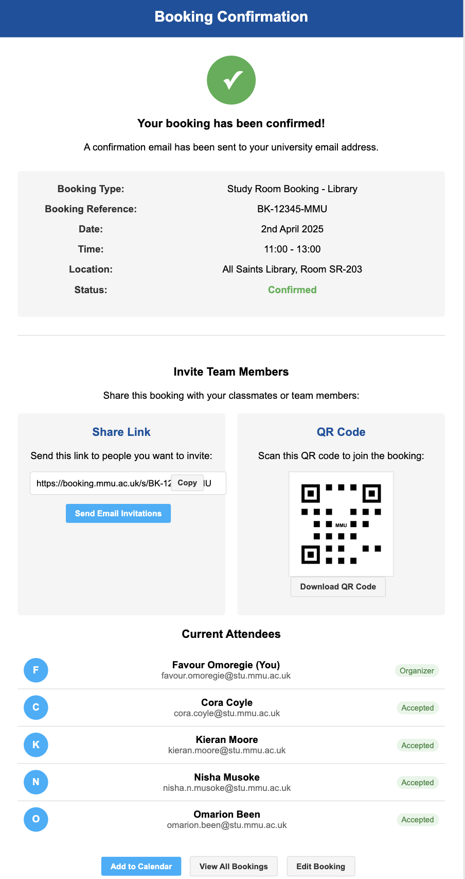
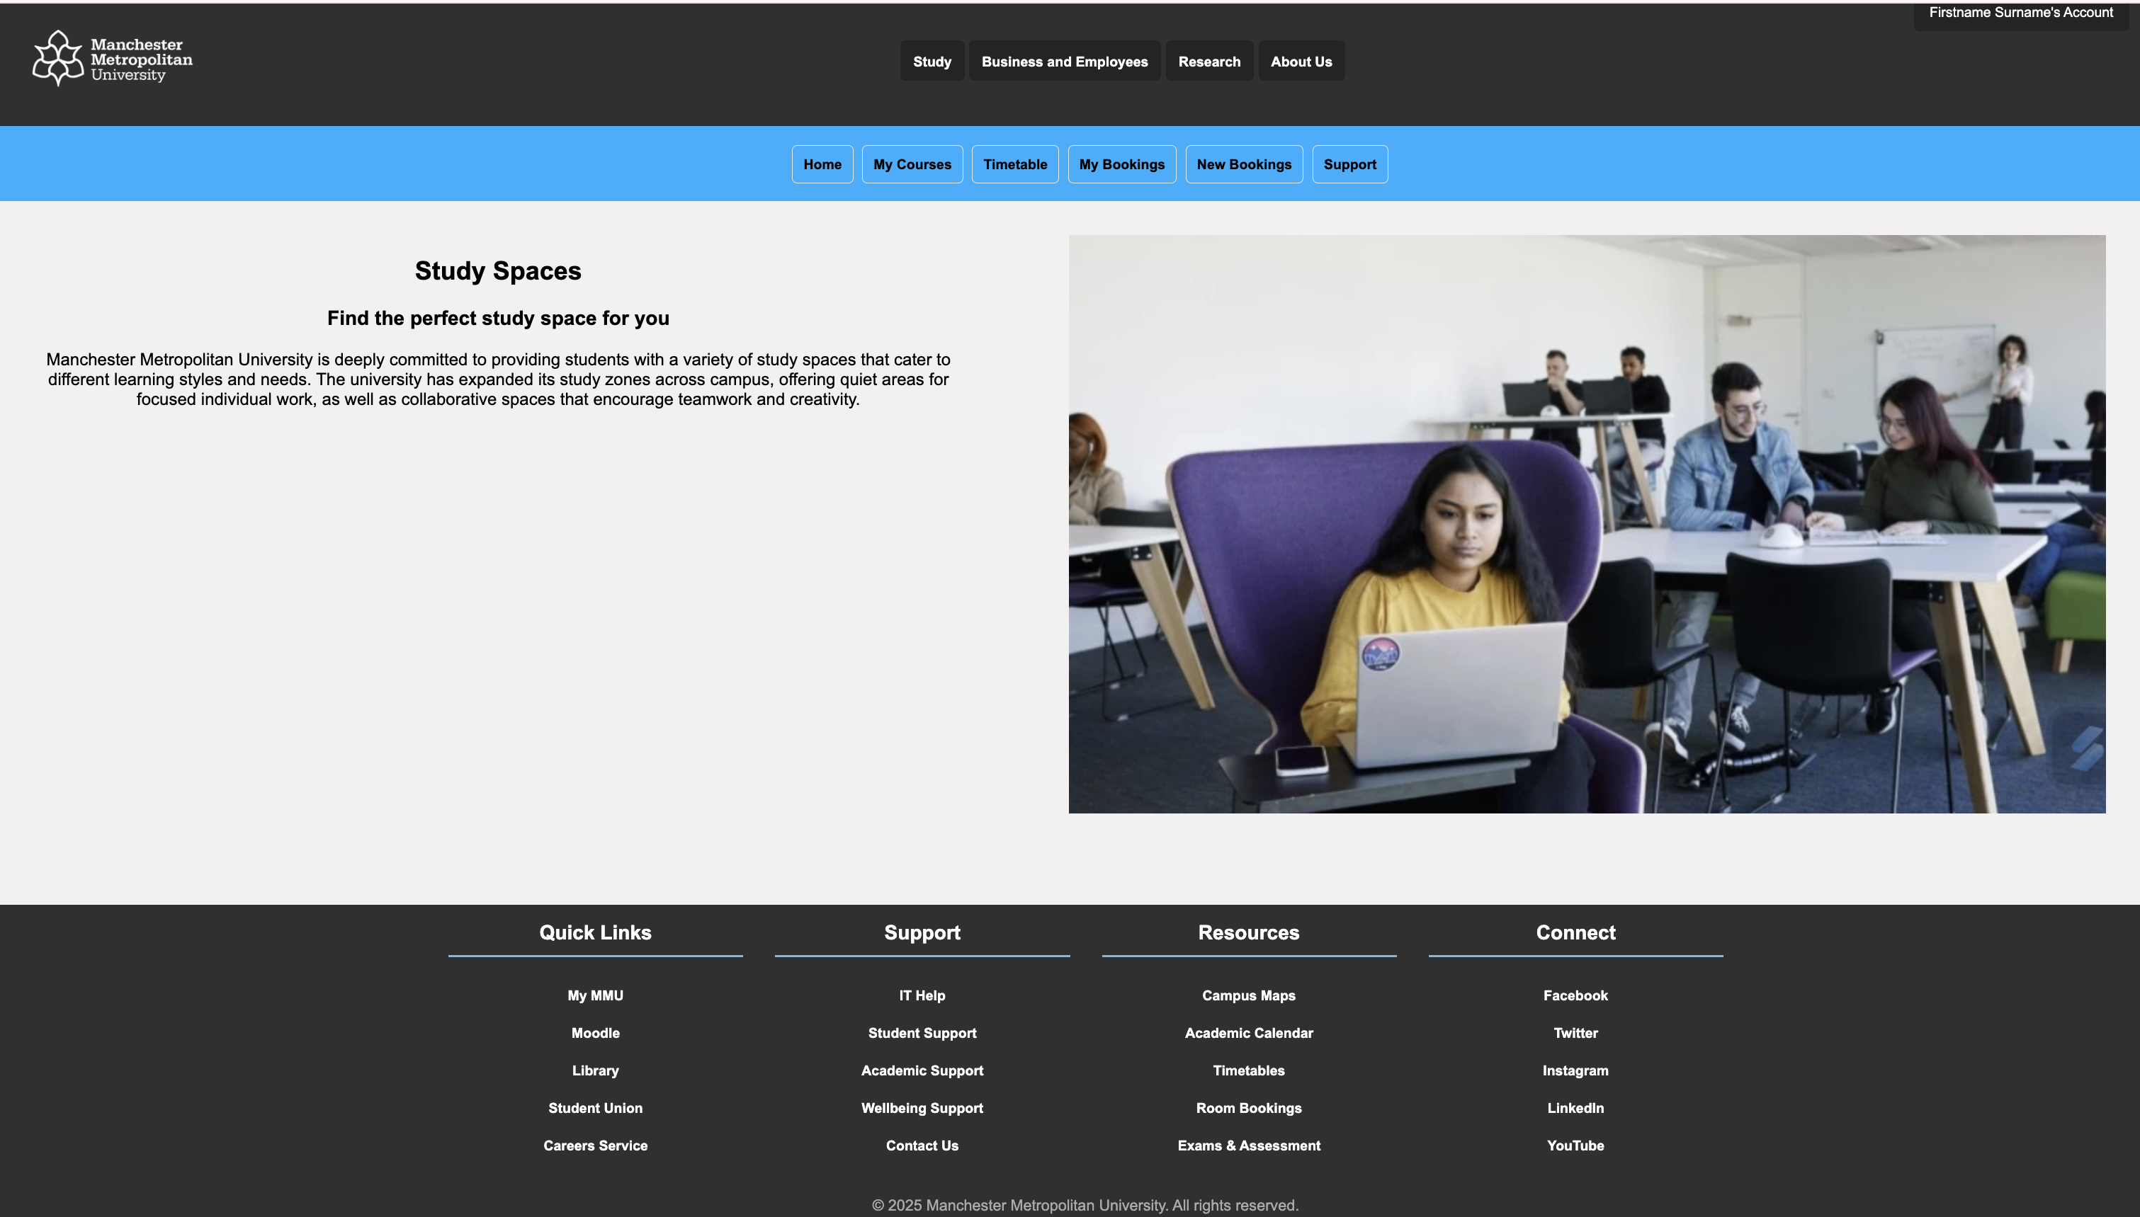
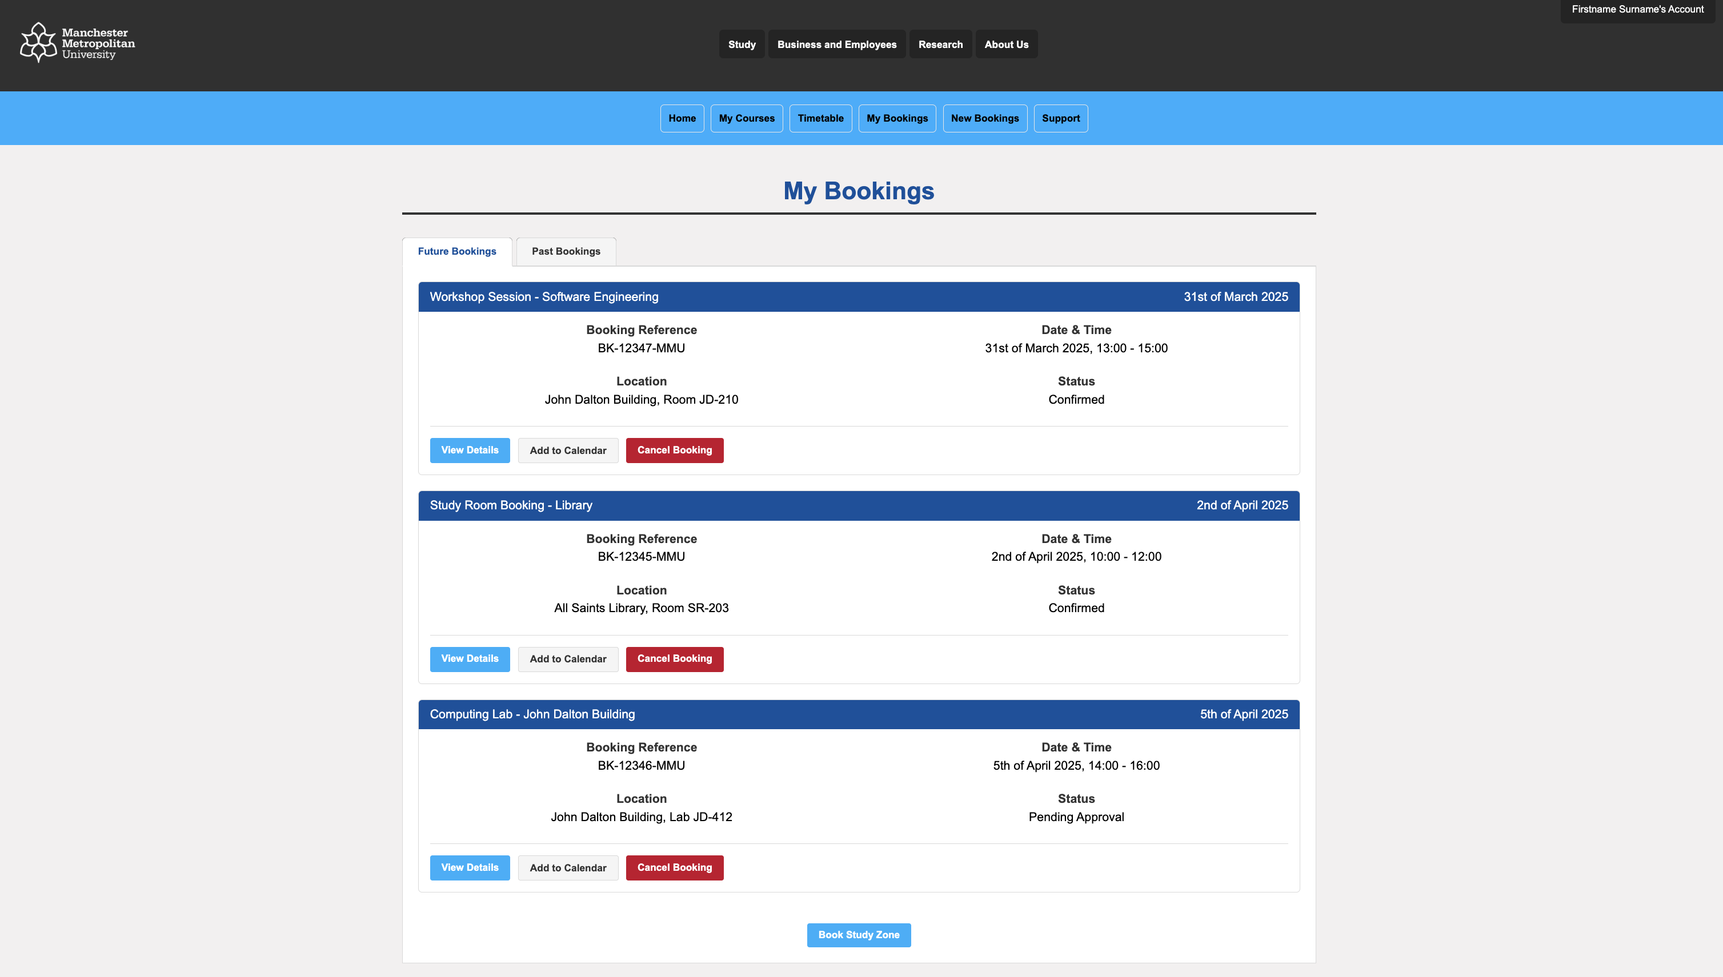
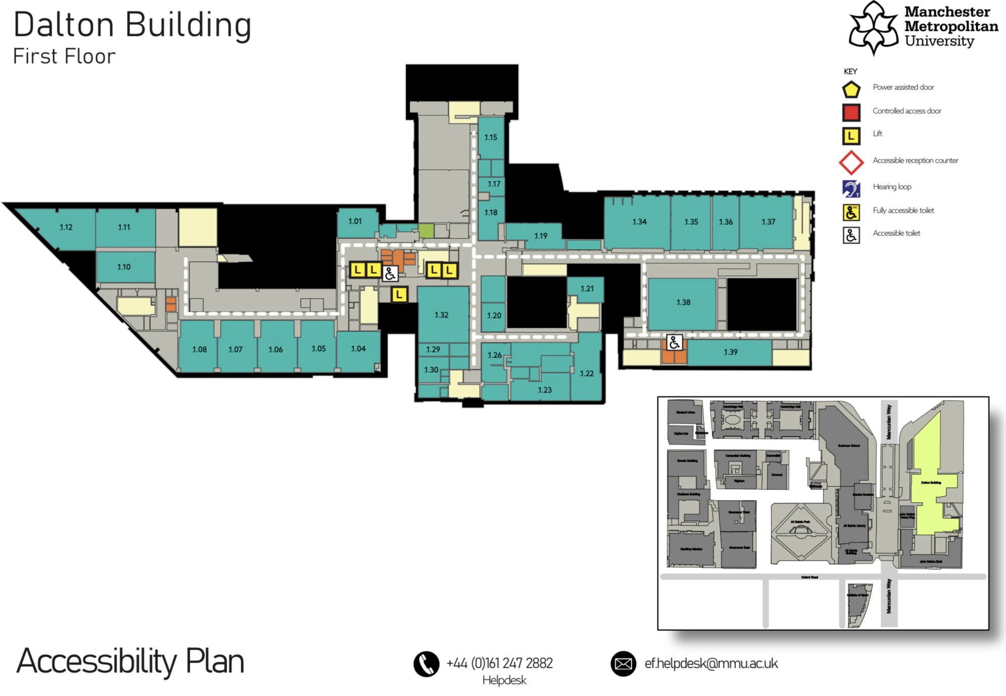
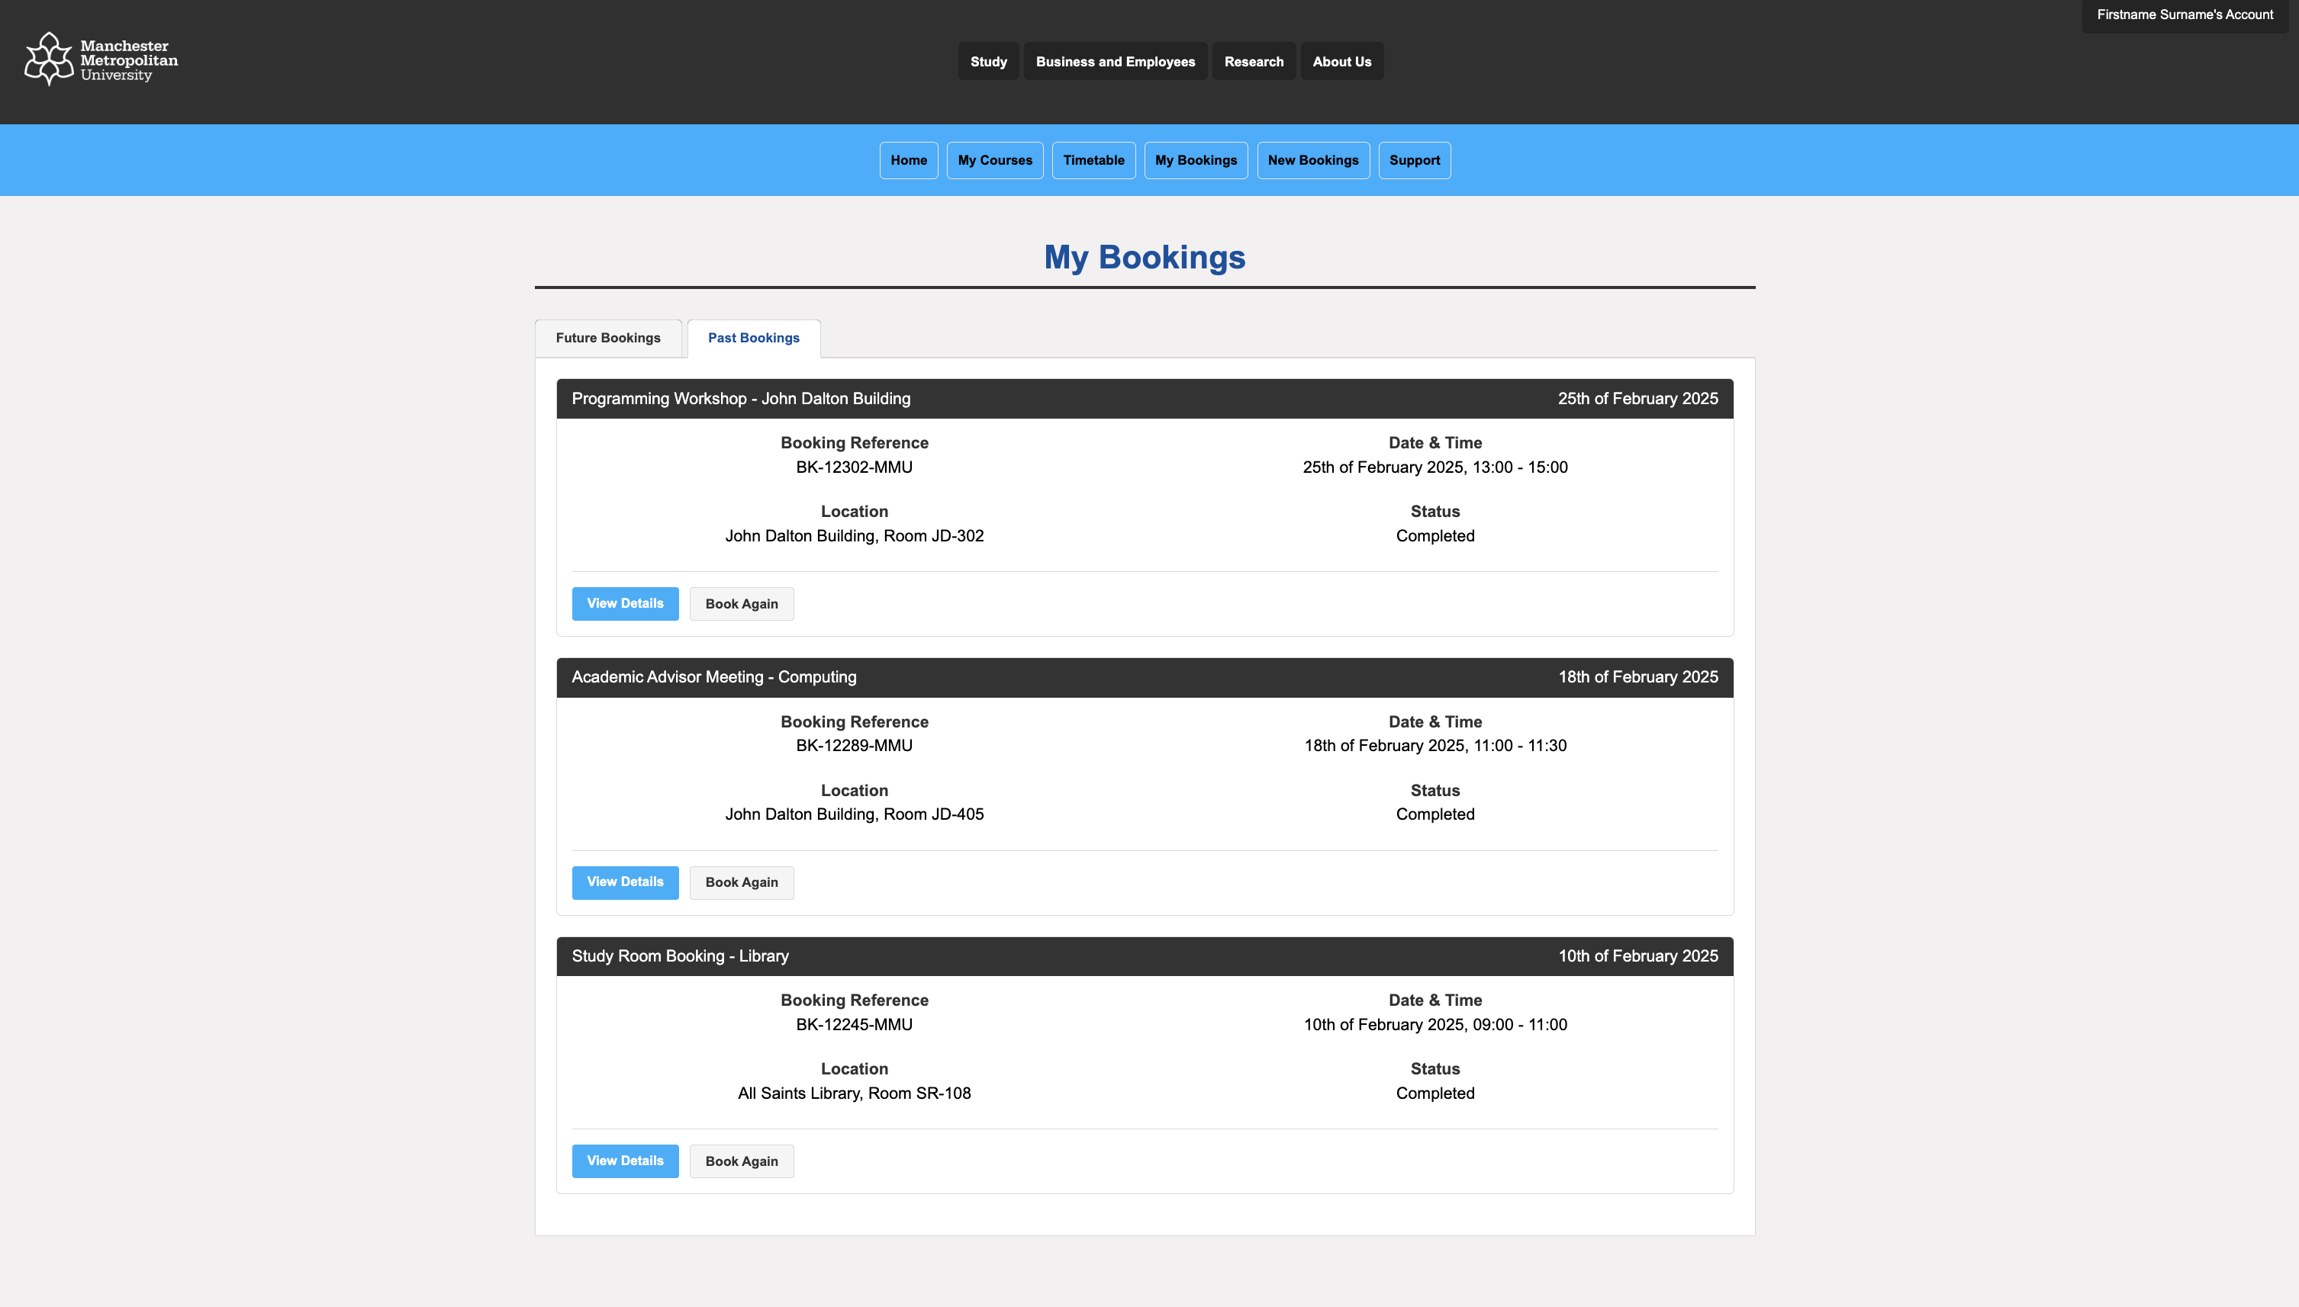
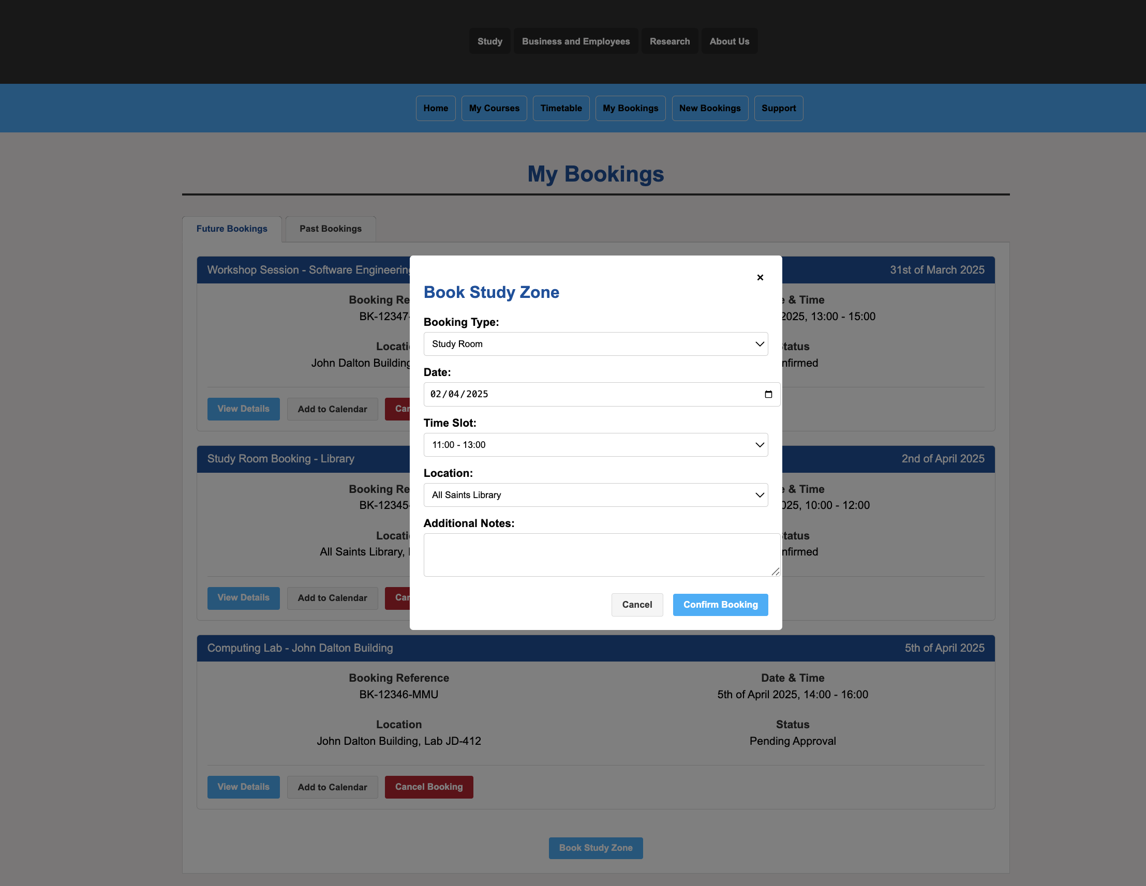
The Product
GROUP A3_5 TEAM PROJECT 24/25
Now presenting ;
Cora
Home page
Future bookings page
Past bookings page
Booking confirmation page
Booking page
Live map
Notes:
Home page was started first so we could use the nav bar and menu as a template
Nisha and favour made the past/future bookings pages and confirmation page, JavaScript. More of a focus on usability, clear navigation and using colours.
Booking page was made separately for easy usability, combined code from Kieran and Nisha.
Live map was made by Omarion, with the concept of showing study space availability in real time.
Once separate work was completed. All code was made cohesive, so all nav bars and footers the same, pages linked together.

Slide 6
Assessment of the product
GROUP A3_5 TEAM PROJECT 24/25
Now presenting ;
Nisha
Discuss the information security issues in relation to the design and development of your product.
Identified one medium severity vulnerability in session management
Implemented data validation for all user inputs against malicious entries
Created Risk Register tracking 6 potential risks (2 high, 4 medium)
Established bi-weekly risk review process with mitigation strategies
Did you effectively meet the objectives of your problem domain?
System meets all core requirements defined in problem domain
Testing coverage: 82% unit, 78% integration tests
Maintained consistent data display across all components
Current quality score: 82/100 with improvement path to 90/100

Slide 7

Testing and Evaluation
GROUP A3_5 TEAM PROJECT 24/25
Now presenting ;
Nisha
How was it tested and assessed?
Used multiple testing approaches: unit (82%), integration (78%), user flow (90%)
Created structured Bug Tracking Report with severity classifications
Identified 2 specific bugs with resolution plans
Performed cross-browser testing and mobile responsiveness verification
Results: 9 test cases with 7 passing (78% success rate)
How was the product evaluated?
Implemented Quality Metrics Dashboard tracking functionality, security, performance
Security assessment: 85% compliance with only one medium vulnerability
Performance metrics: 1.2s page load, 2.5s booking creation time
100% navigation success rate and data consistency
Overall quality score: 82/100 (target: 90/100)
(Lalitbhamare, Evaluating and empowering testers in agile teams 2021)

Slide 8
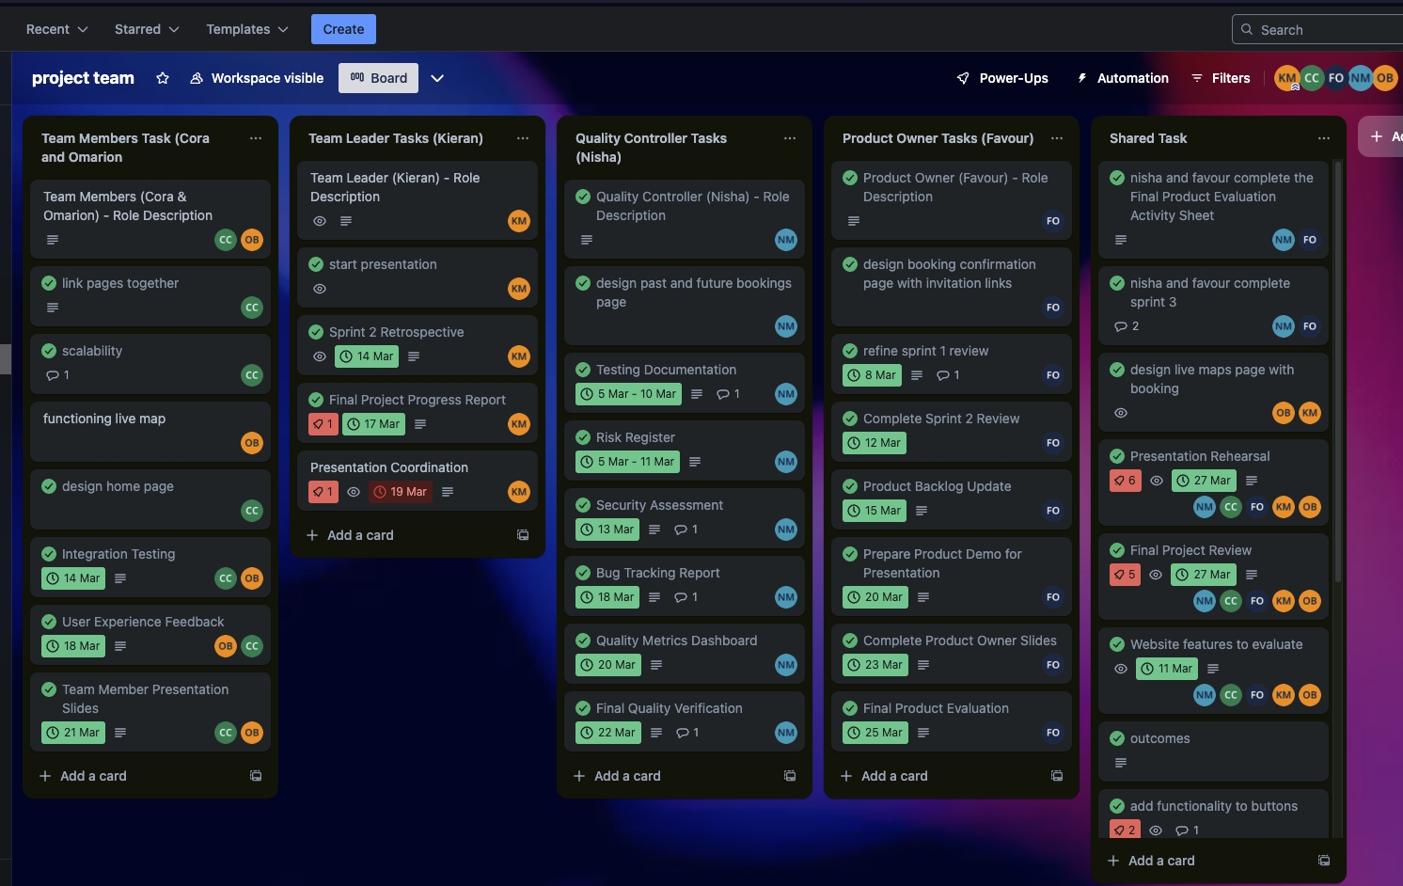
How we worked as a team
GROUP A3_5 TEAM PROJECT 24/25
Now presenting ;
Omarion
The development of the platform was divided amongst each member.
The rest of the work was divided according to the roles.
screenshot of our trello board :
Organisation of Roles:
Team Leader
Product Owner
Quality Controller
Team members
How we Functioned as a team
Clear role assignment, Task allocation and organisation
Communication methods
Collaborative development and support
Testing and feedback
Final review and adjustments
Notes:
The development of the platform was divided amongst each member. Each web page designed by one person. The live map and booking page required pair programming due to its many features.
The rest of the work was divided according to the roles.
1. Team Leader (Project Manager)
Acted as the main coordinator, ensuring tasks were completed on time.
Facilitated communication between team members and handled any conflicts.
Organized meetings, set deadlines, and ensured progress aligned with project goals.
Helped resolve any roadblocks team members faced.
2. Product Owner
Focused on the user experience and functionality of the booking website.
Defined key requirements and ensured that the final product met user needs.
Gathered feedback and worked closely with the team to refine features.
Ensured that all implemented features aligned with the project’s vision.
3. Quality Controller
Reviewed the code, design, and functionality to ensure a high-quality product.
Conducted testing (e.g., usability testing, bug checks) and suggested improvements.
Ensured best practices in development were followed.
Provided feedback to developers to improve the system before the final submission.
4 & 5. Team Members (Developers/Designers)
Focused on coding, designing, and implementing the booking website.
Worked on frontend, backend, and database development.
Followed assigned tasks and collaborated on features like authentication, booking management, and UI design.
Regularly updated the team on their progress and sought help when needed.
How We Functioned as a Team
Clear Role Assignment: Each person had a defined role, which prevented confusion and overlap of tasks.
Task allocation and organisation:
Structured project board with clearly defined tasks for each role
Weekly task assignments with regular progress tracking
Collaborative decision-making for interdependent components
Effective Communication: Used team meetings, messages, and collaborative tools (e.g., Trello, GitHub) to stay aligned.
Communication methods:
Regular team meetings
Shared documentation and progress reports
Digital communication channels for immediate problem solving
Collaboration & Support: Team members helped each other when needed, ensuring no one fell behind.
Collaborative development:
Code review sessions to ensure quality
Knowledge sharing across different technical areas
Joint testing and feedback implementation
Testing & Feedback Loop: The Quality Controller ensured that issues were addressed before the final submission.
Final Review & Adjustments: Before submission, the entire team reviewed the project and made necessary refinements

Slide 9

Challenges and Solutions
GROUP A3_5 TEAM PROJECT 24/25
Now presenting ;
Kieran
The challenges faced while solving the problem domain as a team
Defining clear Requirements
Technical challenges
Team Coordination
Time Management
Communication Gaps
How did the team solve these issues
Regular Meetings
Task Delegation
Version Control
Prototyping and Feedback
Clear documentation
(Powers et al., 3 solutions to help HR adjust to new challenges 2020)
Notes:
Defining Clear Requirements: The team had to ensure that all features (such as booking, cancellations, and user authentication) were well-defined and met user needs.
Technical Challenges: Implementing the booking functionality, managing database conflicts, and ensuring real-time availability were complex.
Team Coordination: Balancing different schedules, work styles, and responsibilities was difficult.
Time Management: Meeting deadlines while balancing university coursework and personal commitments was a struggle.
Communication Gaps: Misunderstandings about tasks and expectations led to delays or rework.
How the Team Solved These Issues
Regular Meetings: Scheduled weekly check-ins to track progress and address issues early.
Task Delegation: Divided tasks based on team members’ strengths (e.g., coding, UI design, database management).
Version Control: Used Git/GitHub to collaborate and prevent code conflicts.
Prototyping & Feedback: Created wireframes before development to align expectations and avoid last-minute changes.
Clear Documentation: Maintained shared documents for requirements, deadlines, and task lists

Slide 10
Lessons learnt as a team
GROUP A3_5 TEAM PROJECT 24/25
Now presenting ;
Kieran
What did we learn about interpersonal skills in team working?
Active Listening
Constructive Feedback Adaptability
Conflict Resolution
What did we learn about organisation and structure in your team?
Importance of Clear Roles
Structured Workflow
Iterative Approach Works Best
What did we learn about personal and team responsibilities?
Personal Responsibility
Team Dependence
Accountability
Notes:
What I Learned About Interpersonal Skills in Team Working
Active Listening: Understanding different perspectives improved collaboration.
Constructive Feedback: Giving and receiving feedback without conflict made the project better.
Adaptability: Being open to changes and last-minute fixes was necessary.
Conflict Resolution: Addressing issues early prevented bigger misunderstandings.
What I Learned About Personal and Team Responsibilities
Personal Responsibility: Meeting deadlines and communicating progress was crucial for team success.
Team Dependence: Everyone’s contribution mattered, and one person falling behind impacted the entire project.
Accountability: Regular updates and check-ins helped ensure no one was left behind.
What I Learned About Organization and Structure in the Team
Importance of Clear Roles: Assigning specific roles (e.g., frontend, backend, project manager) helped efficiency.
Structured Workflow: Using tools like Trello or Notion kept tasks organized.
Iterative Approach Works Best: Breaking down tasks into milestones helped track progress and adapt to changes.

Slide 11
GROUP A3_5 TEAM PROJECT 24/25
Now presenting ;
Omarion
Questions

Slide 12
Sources
GROUP A3_5 TEAM PROJECT 24/25
How can you evaluate the performance of Your Project Team? (no date) How to Evaluate the Performance of Your Project Team. Available at: https://www.linkedin.com/advice/3/how-can-you-evaluate-performance-your-project-team-gebgf (Accessed: 20 March 2025).
How to evaluate group work: Center for Teaching Innovation (no date) How to evaluate group work | Center for Teaching Innovation. Available at: https://teaching.cornell.edu/teaching-resources/active-collaborative-learning/collaborative-learning/how-evaluate-group-work (Accessed: 20 March 2025).
Lalitbhamare (2021) Evaluating and empowering testers in agile teams, Tales of Testing. Available at: https://talesoftesting.com/evaluating-and-empowering-testers-in-agile-teams/ (Accessed: 28 March 2025).
Powers, B. et al. (2020) 3 solutions to help HR adjust to new challenges, HR Daily Advisor. Available at: https://hrdailyadvisor.blr.com/2020/05/22/3-solutions-to-help-hr-adjust-to-new-challenges/ (Accessed: 28 March 2025).

